Slide 1
RISE 1_1
DAY 1 : MILLIONAIRE MINDSET
INTRO: INTRODUCTION & ORIENTATION
MODEL: RISE UP MODEL & GOVERNANCE
SELF: SELF DISCOVERY
GOAL: KNOW YOUR GOAL
PERSEVERANCE: PERSEVERANCE WHEEL
SUCCESS: FAIL PROOF YOURSELF
SUCCESS KIT - DAILY

Slide 2
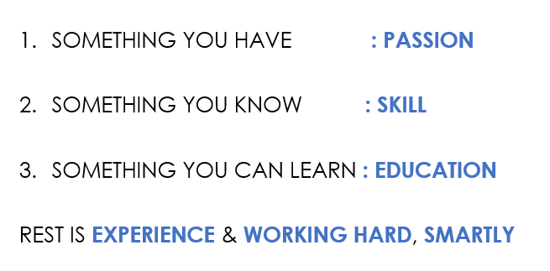
MILLIONAIRE MINDSET
DIGITAL BUSINESS ENGINEERING & GROWTH PLANNING: INTRODUCTION
Digital Business ENGINEERING
Digital Business Growth
DAY 1
INTRO | MODEL | SELF | GOAL | PERSEVERANCE | SUCCESS
SUCCESS FORMULA :
SOMETHING YOU HAVE : PASSION
SOMETHING YOU KNOW : SKILL
SOMETHING YOU CAN LEARN : EDUCATION
REST IS EXPERIENCE & WORKING HARD, SMARTLY
DIGITAL BUSINESS HUB

Slide 3
MILLIONAIRE MINDSET
DIGITAL BUSINESS ENGINEERING & GROWTH PLANNING: INTRODUCTION
Digital Business ENGINEERING
Digital Business Growth
DAY 1
INTRO | MODEL | SELF | GOAL | PERSEVERANCE | SUCCESS
Understanding Knowledge Business:
Application of knowledge and processes – e.g Advisory
The Creator Economy:
Technology facilitated economy that enables creators to earn revenue from their creation – e.g influencers
Business Models :
[GOODs : Mfg : B2C, D2C, B2B] & [SERVICES: Distribution, Retail|B2C, D2C, B2B, Aggregators, Franchise]
Reasons for Failure:
Lacking Process, Lack of Resources, Lacking a Mission, Initiation/Complacency, Lack of Experience
Principles for Success:
Education, Risk Taking Capabilities, Problem Solver Attitude, Sales as a Service, Automate to Scale, RISE to Grow,
DIGITAL BUSINESS HUB

Slide 4
MILLIONAIRE MINDSET
DIGITAL BUSINESS ENGINEERING & GROWTH PLANNING: INTRODUCTION
Digital Business ENGINEERING
Digital Business Growth
DAY 1
INTRO | MODEL | SELF | GOAL | PERSEVERANCE | SUCCESS
Categorize Yourself : 3 Ways
Novice | Expert | Master & Pioneer
The ecosystem in the Digital World
Website|LMS|Commn System|Sales System|Community Building|Payment System|Automation & Integration
Delivering Expertise:
Do it For You | Do It With You | 121 Coaching |Group Coaching | Digital Ecosystem
Pillars To Rise: 4
Passion: Knowledge, Purpose, Skill, Desire | Foundation: Goals, Mind, Habit, Activities
RISE UP Model
LIVE | STRIVE | THRIVE : Result Planning, Innovate & Create, Sales & Mktg as a Service, Earning Management , Utilize and Diversify, Pioneering
DIGITAL BUSINESS HUB

Slide 5

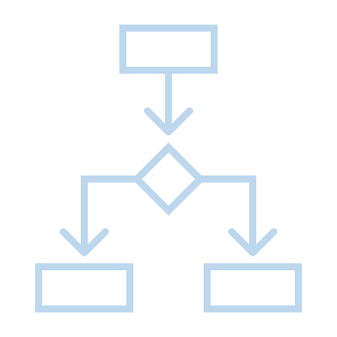

DIGITAL BUSINESS ENGINEERING & GROWTH PLANNING: MODEL ORIENTATION
Digital Business ENGINEERING
Digital Business Growth
DAY 1
INTRO | MODEL | SELF | GOAL | PERSEVERANCE | SUCCESS
DIGITAL
BUSINESS
PIONEER
DIGITAL PLATFORM FOR INCOME GROWTH
BLITZSCALING
DIGITAL ASSET CREATION & MONETIZATION
DIGITAL BUSINESS ENGINEERING & GROWTH PLANNING
DIGITAL CONSULTING
AS A BUSINESS
RISE 6
CONSULT AND COACH LARGE CORPORATES WITH MONK MINDSET & 5T SKILLS
RISE 5
BECOMING A POINEER AND CONSULTING FOR DIGITALIZATION & CHANGE MANAGEMENT CONSULTING IN YOUR FIELD
RISE 4
SCALING THE BUSINESS THROUGH AUTOMATION, TRIBE BUILDING & INCOME GROWTH THROUGH VARIOUS PLATFORMS
RISE 3
RISE 2
RISE 1
DIGITAL ECOSYSTEM SETUP FOR SCALING THROUGH SALES & MARKETING
DIGITAL ASSET CREATION FOR MONETIZATION
DIGITAL ASSET FOR KNOWLEDGE BUSINESS, STRATEGY & PLANNING
PIONEERING & PASSING THE LEGACY
UTILIZE & DIVERSIFY
EARNINGS & INCOME MANAGMENT
SALES & MARKETING AS A SERVICE
INNOVATE & CREATE
RESULT PLANNING
THRIVE
SOM
STRIVE
MONK QUANTUM PLATINUM DIAMOND GOLD SILVER
RISEUP IMPACT OPINE TUNE
LIVE
TOB
TIB
FOUNDATION
GOALS
MIND
HABIT
ACTIVITIES
DIGITAL BUSINESS HUB
PASSION
KNOWLEDGE
PURPOSE
SKILL
DESIRE
EXPERIENCE

Slide 6
DIGITAL BUSINESS ENGINEERING & GROWTH PLANNING: GOVERNANCE
Digital Business ENGINEERING
Digital Business Growth
DAY 1
INTRO | MODEL | SELF | GOAL | PERSEVERANCE | SUCCESS
DIGITAL
BUSINESS
PIONEER
DIGITAL PLATFORM FOR INCOME GROWTH
BLITZSCALING
DIGITAL ASSET CREATION & MONETIZATION
DIGITAL BUSINESS ENGINEERING & GROWTH PLANNING
DIGITAL CONSULTING
AS A BUSINESS
GOVERNANCE:
Weekly Inner Circle Meet: 1.5 hr
  For clarifications
  Feedback
  Support
Monthly Challenge Achievers Club: 1.5hr
  Practicals / Hacks
  Gamification
  Rewards & Recognition
Quantum Leadership Meet: 1.5 hr.
  Strategic Direction
  Collective Criticism & Opinion
  Event Roadmap creation
  Quantum Nominations
RISE 6
CONSULT AND COACH LARGE CORPORATES WITH MONK MINDSET & 5T SKILLS
RISE 5
BECOMING A POINEER AND CONSULTING FOR DIGITALIZATION & CHANGE MANAGEMENT CONSULTING IN YOUR FIELD
RISE 4
SCALING THE BUSINESS THROUGH AUTOMATION, TRIBE BUILDING & INCOME GROWTH THROUGH VARIOUS PLATFORMS
RISE 3
RISE 2
RISE 1
DIGITAL ECOSYSTEM SETUP FOR SCALING THROUGH SALES & MARKETING
DIGITAL ASSET CREATION FOR MONETIZATION
DIGITAL ASSET FOR KNOWLEDGE BUSINESS, STRATEGY & PLANNING
PIONEERING & PASSING THE LEGACY
UTILIZE & DIVERSIFY
EARNINGS & INCOME MANAGMENT
SALES & MARKETING AS A SERVICE
INNOVATE & CREATE
RESULT PLANNING
THRIVE
SOM
STRIVE
MONK QUANTUM PLATINUM DIAMOND GOLD SILVER
RISEUP IMPACT OPINE TUNE
LIVE
TOB
TIB
FOUNDATION
GOALS
MIND
HABIT
EVENTS
DIGITAL BUSINESS HUB
PASSION
KNOWLEDGE
PURPOSE
SKILL
DESIRE
EXPERIENCE

Slide 7
DIGITAL BUSINESS ENGINEERING & GROWTH PLANNING: PHASES
Digital Business ENGINEERING
Digital Business Growth
DAY 1
INTRO | MODEL | SELF | GOAL | PERSEVERANCE | SUCCESS
DIGITAL
BUSINESS
PIONEER
DIGITAL PLATFORM FOR INCOME GROWTH
BLITZSCALING
DIGITAL ASSET CREATION & MONETIZATION
DIGITAL BUSINESS ENGINEERING & GROWTH PLANNING
DIGITAL CONSULTING
AS A BUSINESS
RISE 6
CONSULT AND COACH LARGE CORPORATES WITH MONK MINDSET & 5T SKILLS
RISE 5
BECOMING A POINEER AND CONSULTING FOR DIGITALIZATION & CHANGE MANAGEMENT CONSULTING IN YOUR FIELD
RISE 4
SCALING THE BUSINESS THROUGH AUTOMATION, TRIBE BUILDING & INCOME GROWTH THROUGH VARIOUS PLATFORMS
RISE 3
RISE 2
RISE 1
DIGITAL ECOSYSTEM SETUP FOR SCALING THROUGH SALES & MARKETING
DIGITAL ASSET CREATION FOR MONETIZATION
DIGITAL ASSET FOR KNOWLEDGE BUSINESS, STRATEGY & PLANNING
PIONEERING & PASSING THE LEGACY
UTILIZE & DIVERSIFY
EARNINGS & INCOME MANAGMENT
SALES & MARKETING AS A SERVICE
INNOVATE & CREATE
RESULT PLANNING
THRIVE
SCALE
SOM
STRIVE
90DAYS
SELL
MONK QUANTUM PLATINUM DIAMOND GOLD SILVER
RISEUP IMPACT OPINE TUNE
30DAYS
SETUP
LIVE
TOB
10DAYS
MIDSET FOCUS
TIB
FOUNDATION
GOALS
MIND
HABIT
EVENTS
DIGITAL BUSINESS HUB
PASSION
KNOWLEDGE
PURPOSE
SKILL
DESIRE
EXPERIENCE

Slide 8
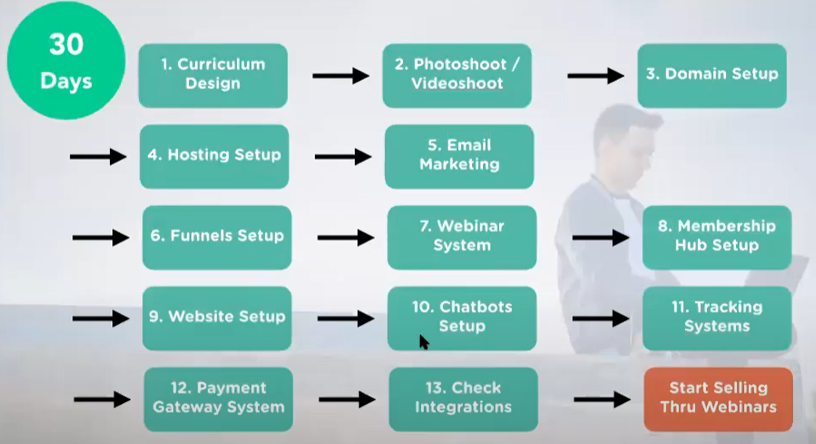












DIGITAL BUSINESS ENGINEERING & GROWTH PLANNING: 90 Day Plan
Digital Business ENGINEERING
Digital Business Growth
DAY 1
INTRO | MODEL | SELF | GOAL | PERSEVERANCE | SUCCESS
FINISH 90 DAYS
30 DAYS
DIGITAL ASSET CREATION
DIGITAL ASSET
CREATION
COMPLETE 50
Consultations
RESULT PLANNING
FUNNEL
BUILDING
BUILD
SOCIAL GROUP
SCALE
90DAYS
SELL
NICHE CLARITY
LAUNCH ASSET
SETUP SYSTEMS
30DAYS
SETUP
RISE UP MODEL
LEAD MAGNET
LAUNCH
10DAYS
MIDSET FOCUS
START

Slide 9


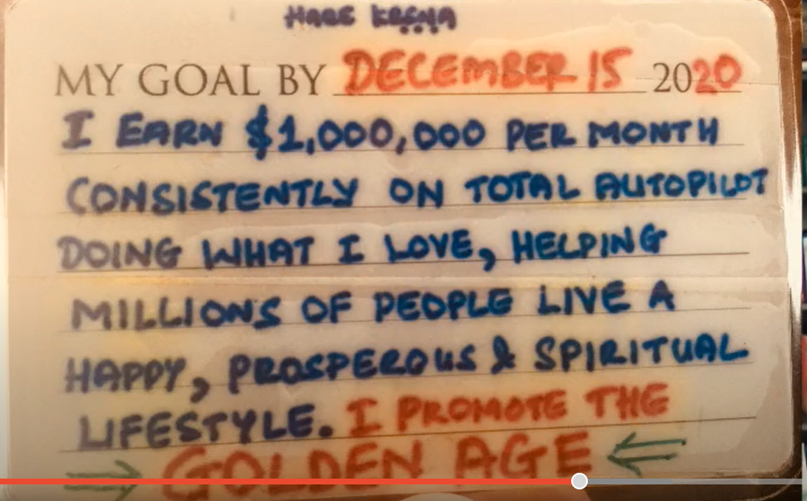

DIGITAL BUSINESS ENGINEERING & GROWTH PLANNING: KNOW YOUR GOAL
SELF DISCOVERY
DAY 1
INTRO | MODEL | SELF | GOAL | PERSEVERANCE | SUCCESS
What is Your PQ
Immediate goal : short term goal 1-2 years
Aspirational goals
Set your intentions and goals
MONK QUANTUM PLATINUM DIAMOND GOLD SILVER
MY GOAL CARD
MY GOAL CARD
20____
DIGITAL BUSINESS HUB

Slide 10




DIGITAL BUSINESS ENGINEERING & GROWTH PLANNING: PERSEVERANCE WHEEL
GOAL PERSEVERANCE
DAY 1
INTRO | MODEL | SELF | GOAL | PERSEVERANCE | SUCCESS
INSPIRATION
GOAL
WORK
RETREAT
OBSTACLES
MONK QUANTUM PLATINUM DIAMOND GOLD SILVER
PUSH & PERSEVERANCE
MINDSET & MISSION
BOOKS & THE COMPANY YOU KEEP
Motivation video : Eagles Flight
Strangest Secret: EARL Nightingale
DIGITAL BUSINESS HUB

Slide 11

DIGITAL BUSINESS ENGINEERING & GROWTH PLANNING: MAKE YOURSELF RESILIENT
FAIL-PROOF YOURSELF
DAY 1
INTRO | MODEL | SELF | GOAL | PERSEVERANCE | SUCCESS
SUCCESS FORMULA :
SOMETHING YOU HAVE : PASSION
SOMETHING YOU KNOW : SKILL
SOMETHING YOU CAN LEARN : EDUCATION
REST IS EXPERIENCE & WORKING HARD, SMARTLY
MONK QUANTUM PLATINUM DIAMOND GOLD SILVER
Motivation video: EAGLES Flight
Strangest Secret: EARL Nightingale
https://www.youtube.com/watch?v=XLPqy2oO-Eg&t=8s
https://www.youtube.com/watch?v=NbBHR_CD56M&t=22s
DIGITAL BUSINESS HUB
BUILD YOUR COMMUNITY

Slide 12
DIGITAL BUSINESS ENGINEERING & GROWTH PLANNING: YOUR DIGITAL KIT
EVERYDAY DIGITAL KIT
INTRO | MODEL | SELF | GOAL | PERSEVERANCE | SUCCESS
DOWNLOAD
Goal card
Ebook of success: https://jsnagi.ck.page/higherself
Wall Placard: RISE UP
MY GOAL CARD
RISE
UP
1. FOLLOW THE HIGHWAY
Create the Treasure Chest
2.TUNE TO THE FREQUENCY OF YOUR THOUGHT .PATTERN
Understand thought pattern from the Treasure Chest
3. USE POWER OF INTENT
Use the right attitude to form intent
4. 6 SPIRITUAL LAWS OF SUCCESS
USE 4 SPIRITUAL RULES
DIGITAL BUSINESS HUB
MONK QUANTUM PLATINUM DIAMOND GOLD SILVER
INFINITY
MY GOAL CARD
20____
Know Yourself
Find Your Capacity to Give and Accept
Avoid Blocks
Passion Aligned with Natures Positivity
DIGITAL BUSINESS HUB

Slide 13
MILLIONAIRE MINDSET
DIGITAL BUSINESS ENGINEERING & GROWTH PLANNING: YOUR SELF CLARIFICATION SHEET
Digital Business ENGINEERING
Digital Business Growth
DAY 1 : HOMEWORK BUSINESS TEMPLATE
1 | What problem do you want to solve
2 | How do you plan to solve this
 | Purpose
3 | Positioning
 | Niche
 | Target Mkt
 | Mission statement
 | Name of the Hub: Community
 | Personal Designation
4 | 3 Secrets
 | How
 | Where
 | When
5 | Methodology
 | Step 1- 6
6 | COURSE : BLUEPRINT : LEVEL 1
 | VALUE with BONUS :
7 | COURSE : CHALLENGE : LEVEL 2
 | VALUE WITH BONUS:
8 | COURSE : CONSULTING : LEVEL 3
 | VALUE :
10 | Entry Webinar
 | Webinar topic 1
 | Webinar Topic 2
 | Webinar TOPIC 3
11 | SETUP: Co. Name | Domains
 | Company name | XYZ Pvt / LLP
 | Website | Yournam.com/brand.com
 | Hub | Hub_brand.com
 | Click Tracking | XYZ.co
 | Manychat (OPT) | askXYZ .com
12 | Governance
 | 1 Wkly – innercircle
 | 1 Wkly – challenge / gamification
13 | Philanthrophy
 | Charity
DOWNLOAD
10 steps for becoming a focused expert in the digital age: Niche to Positioning :
RISE1_FOCUSED EXPERT_Playbook.pdf
DIGITAL BUSINESS HUB

Slide 14
SAMPLE

Slide 15

DIGITAL BUSINESS ENGINEERING & GROWTH PLANNING
Digital Business Planning
Digital Business Growth
Niche | Digitalization Consulting & Digital Business Planning For Creating Digital Assets
Target Mkt | Solopreneurs and SME Businesses, Executives of LE who would like to be a part of the Knowledge and Creator economy in the Digital Age | Services Through Consulting & Courseware
Designation | RISE BUSINESS PARTNER at SOUL
Mission | To Make 1 M people and businesses RISE to their goals
Community | RISE DIGITAL BUSINESS ACADEMY
PRODUCT | RISE UP DIGITAL BUSINESS MODEL
SERVING INDIVIDUALS & BUSINESSES TO SUCCEED IN THE DIGITAL AGE
By helping in Creating and distributing Digital Assets for Knowledge and Creator economy through a P2P model to RISE UP to the Success you are seeking.
INITIAL
WEBINAR Topic:
Passion Circle
80% Passion + 10% clarity on growth or life to lead + 10% Experience
PITCH | To provide the experience to people and businesses with deep passion (80%) & some clarity (10%) on the growth they want the life they want to lead but lack the experience & guidance (10%) to complete their passion circle
 | RISE UP WITH SOUL ( SOUL provides the experience and knowledge ) : Through the RISE UP Framework
PURPOSE | SOUL provides guidance through consulting and experience using courseware and authored books
GAP to Fill | People with PASSION lacking experience
 | Knowledge | Purpose | Skill | Desire | = PASSION
PRODUCTS & SERVICS
COURSEWARE & BOOKS | Business Planning & Growth | PRODUCT
B/VLOGS & PODCAST | Digitalization
 | Change Management Consulting
 | Digital Asset Creation & Selling
CONSULTING | CHANGE MANGEMENT | SERVICES
ADVISORY | DIGITALIZATION
 | Digital Business Planning for Solopreneurs & Startup
LIVE
STRIVE
THRIVE
DIGITAL BUSINESS HUB

Slide 16
DIGITAL BUSINESS ENGINEERING & GROWTH PLANNING
Digital Business Planning
Digital Business Growth
Globalnewswire23 June 2021
Global Knowledge Management Market to Reach $1.1 Trillion by 2026
Digital knowledge assets or knowledge-based intellectual property.
knowledge industry: an industry whose success depends on having and using knowledge about a particular subject
Knowledge-Based Services, commonly referred to as Advisory and Assistance Services (A&AS), relate to tasks that require the application of detailed processes or technical knowledge.
Knowledge management is a managerial approach through which an organization collects, analyzes, systematizes, stores, and shares its knowledge assets or knowledge-based intellectual property.
Academic institutions, companies engaging in research and development (R&D), programmers developing new software and search engines for data, and health workers using digital data to improve treatments are all components of a knowledge economy.
These economy brokers pass on the results of their research to workers in more traditional fields, such as farmers who use software applications and digital solutions to manage their crops better, advanced technological-based medical procedures such as robot-assistant surgeries, or schools that provide digital study aids and online courses for students.
What Are the Most Valuable Skills in the Knowledge Economy?
While higher education and technical training are obvious assets, communication and teamwork are also essential skills for a knowledge-based economy, according to the Organization for Economic Cooperation and Development. Since it is unlikely that any single knowledge worker can generate groundbreaking innovations alone, these interpersonal and workplace competencies are essential to surviving in a knowledge-based workplace
https://www.springboard.com/blog/business-and-marketing/creator-economy/
Research shows that millennials don’t respond to traditional advertising, which makes influencer partnerships a crucial part of a brand’s marketing strategy. Creators can also sell content such as ebooks, courses, podcasts, and newsletters on their own website in exchange for a monthly subscription, pay-per-view, or donation.
https://www.robosoftin.com/blog/creator-economy-and-role-of-digital-experience
104 $Bn Industry – 50 mn creators
RESEARCH FOR WEBINAR
LIVE
STRIVE
THRIVE
CREATORPRENEUR
DIGITAL BUSINESS HUB

