Slide 1
RISE 1_5
DAY 5 – BUSINESS PLANNING BLUEPRINT FOR MILLIONAIRE
RESULT PLANNING OVERVIEW
BUSINESS PLAN TEMPLATE
BUSINESS PLAN CHALLENGE – 3 YR. Plan : PRACTICAL

Slide 2
MILLIONAIRE MINDSET
DIGITAL BUSINESS ENGINEERING & GROWTH PLANNING: BUSINESS PLANNING MILLIONAIRE WAY
Digital Business ENGINEERING
Digital Business Growth
DAY 5 :
OVERVIEW | TEMPLATE | PRACTICAL
TOPIC | DESCRIPTION
OVERVIEW
( Digital Business Fundamentals ) | •INTRODUCTION : RISE WITH SOUL : BUSINESS OVERVIEW | RISE UP MODEL
STRATEGY | •STRATEGIC PLANNING : | TIB | TOB | SOM
( Digital Business Strategy Fundamentals ) | •Vision | Mission | Purpose
 | •Digital Asset to be Productized ( service as a product )
 | •Current State | Future State |
 | •Competitive Advantage : NICHE
 | •Road Map: 1 yr. : Curr State to Future State (3M Strategy)
CUSTOMER EXPERIENCE | •CUSTOMER ACQUISITION Overview
 | •Customer Engagement & Communication Strategy : WEBINAR, FUNNEL - DIGITAL SYSTEM
 | •Customer Experience
SALES GROWTH | •SALEs Overview
 | •Revenue Goal
 | •Growing Sales < Lead Gen +Traffic + Plan > : TOOLS : DIGITAL SYSTEM
 | •Team Size [ Tuckman model ]
OPERATION AUTOMATION | •OPERATION EFFICIENCY & ORGANIZATION STRUCTURE
 | •Sales | HR | IT & Admin | Legal | Finance & Accounting | Operations : Mfg., Delivery, Fulfilment, SCM
GROWTH @ Speed of Change | •EXPANSION:
 | •INORG : JV | Partnerships | M&A
 | •ORG : Franchising | Verticalisation | Niche | Mkt Penetration
 | •DIVERSIFICATION: Secondary Prod | Tertiatry Products | Backward Integration
DIGITAL BUSINESS HUB

Slide 3
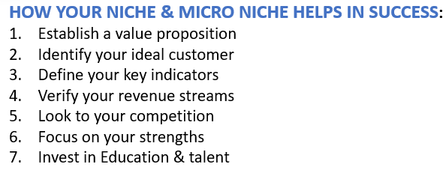
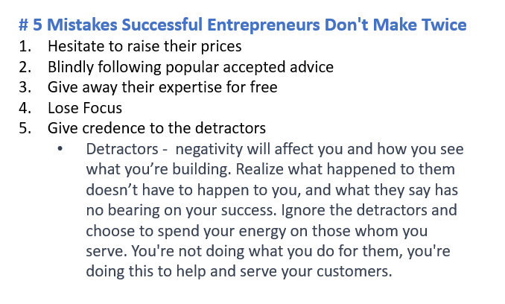
MILLIONAIRE MINDSET
DIGITAL BUSINESS ENGINEERING & GROWTH PLANNING: BUSINESS PLANNING MILLIONAIRE WAY
Digital Business ENGINEERING
Digital Business Growth
DAY 5 :
OVERVIEW | TEMPLATE | PRACTICAL
HOW YOUR NICHE & MICRO NICHE HELPS IN SUCCESS:
Establish a value proposition
Identify your ideal customer
Define your key indicators
Verify your revenue streams
Look to your competition
Focus on your strengths
Invest in Education & talent
# 5 Mistakes Successful Entrepreneurs Don't Make Twice
Hesitate to raise their prices
Blindly following popular accepted advice
Give away their expertise for free
Lose Focus
Give credence to the detractors
  Detractors - negativity will affect you and how you see what you’re building. Realize what happened to them doesn’t have to happen to you, and what they say has no bearing on your success. Ignore the detractors and choose to spend your energy on those whom you serve. You're not doing what you do for them, you're doing this to help and serve your customers.
DIGITAL BUSINESS HUB

Slide 4
MILLIONAIRE MINDSET
DIGITAL BUSINESS ENGINEERING & GROWTH PLANNING: BUSINESS PLANNING MILLIONAIRE WAY
Digital Business ENGINEERING
Digital Business Growth
DAY 5 :
OVERVIEW | TEMPLATE | PRACTICAL
TUCKMAN MODEL : FOR WORKING WITH TEMPORARY TEAMS e.g., FREELANCERS
FORMING | STORMING | NORMING | PERFORMING | ADJOURNING
Introduction of team members and their hobbies, interests and skills | Conflicts arise during meetings or work sessions | Conflicts are much less frequent, and if they do arise, it's easy to solve them | The leader rarely intervenes but instead helps facilitate only when needed | Sadness at the project's ending
Polite, quiet team members | The team questions the authority of the leader or supervisor | All team members understand their specific roles and responsibilities | Team members work autonomously on tasks | Uncertainty about the future
Reliance on the group leader | Team members work to establish what their roles and responsibilities are within the project | The team leader helps delegate work and answers any questions from the team | The project is nearing completion | A sense of loss over the separation of the team
Focus on establishing roles, responsibilities and goals | The team functions more as individual members than as a cohesive unit | The team might socialize together outside of a professional setting | Any conflict is usually constructive and related directly to the project rather than personal disagreements
Development of a project timeline
DIGITAL BUSINESS HUB

Slide 5
MILLIONAIRE MINDSET
DIGITAL BUSINESS ENGINEERING & GROWTH PLANNING: BUSINESS PLANNING MILLIONAIRE WAY
Digital Business ENGINEERING
Digital Business Growth
DAY 5 :
OVERVIEW | TEMPLATE | PRACTICAL
HOMEWORK
DOWNLOAD : BUSS_PLAN_WORKING.xls | SAMPLE BUSS PLAN.docx
FILL out your estimated goals for the revenue in xls
Come prepared for the Practical Session and raise queries if any?
RESULT PLANNING : COMPLETE CERTIFY YOURSELF
DIGITAL BUSINESS HUB

